Slide 1

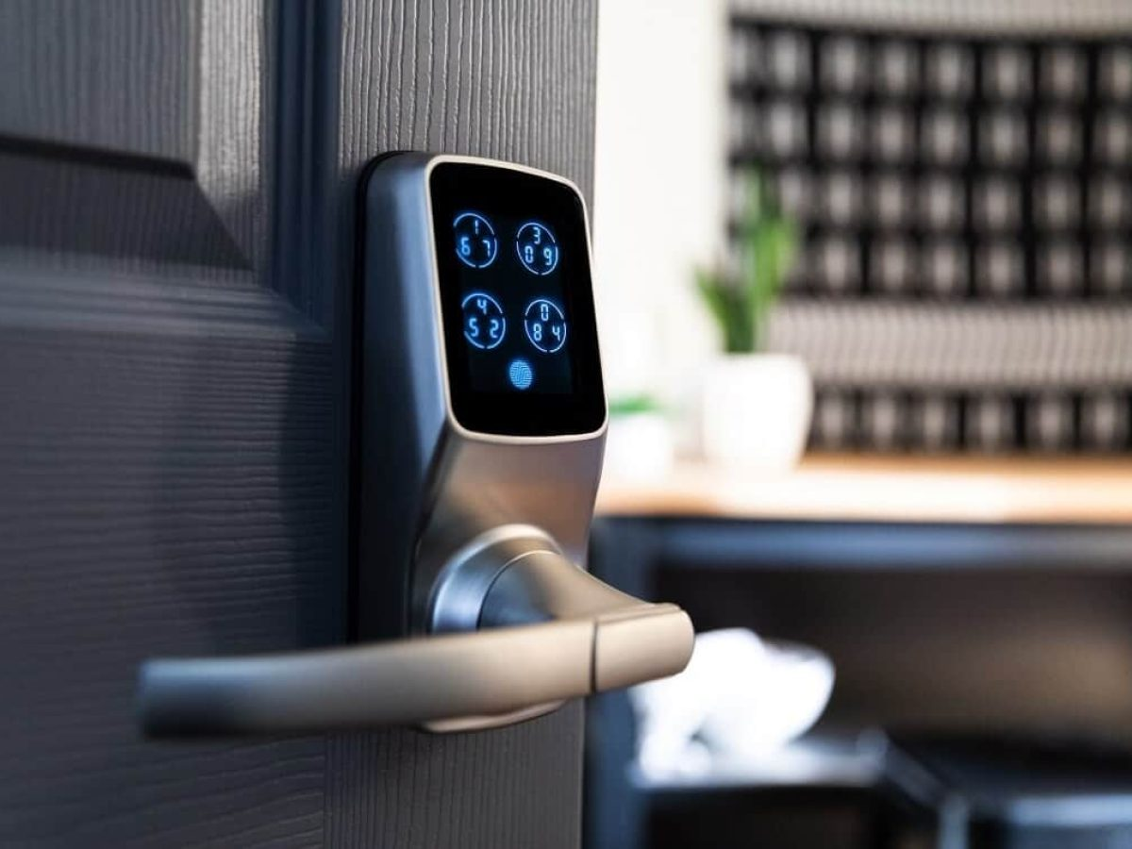
Digital Keypad Security Door Lock using Arduino
UNDER THE GUIDENCE OF:
Dr. N. USHA RANI
Mr. P. KRISHNA CHAITANYA
BY:
V. Lakshmi Revanth kumar 201FA05043
CH. Sai Siva ram 201FA05052
N. Anjana Sri 211LA05007

Slide 2
CONTENTS:
Abstract
Introduction
Circuit diagram
Components
Working
Schematic
Applications
Advantages
Dis advantages
Future Scope
Conclusion

Slide 3
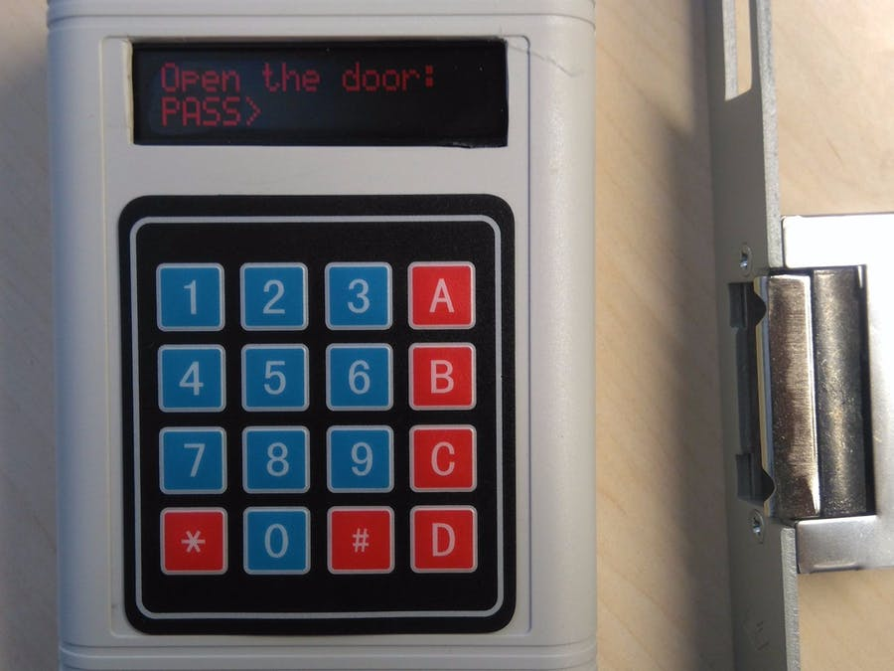
ABSTRACT:
Password based door lock system allows only approved persons to access restricted areas.
This system is fully controlled by Arduino.

Slide 4
INTRODUCTION:
The aim of this project is to create a security system which asks for a password before opening the door and opens the door only if the password matches the programmed keyword.
In this project we will learn how to make the password-based security system using Arduino and keypad. As thefts are increasing day by day security is becoming a major concern now-a-days.
So a digital lock can secure your home or locker easily.
It will open your door only when the right password is entered.
The system has a keypad by which the password can be entered through it. When the entered password equals with the password stored in the memory then the door gets open. if we entered a wrong password then the alarm is switched on.

Slide 5
We can easily access our garage, home, offices, etc without the use of any kind of keys or opening it by ourselves.
Password based door opener system provides us ease with security.
With the help of this system, we can easily avoid the incoming of any offenders, strangers too.
The system includes an electronic control assembly that controls the output load via a numerical password.
An Arduino based door locker is an access control system that allows only authorized persons to access a restricted area.
Hence, provides automation and security.

Slide 6
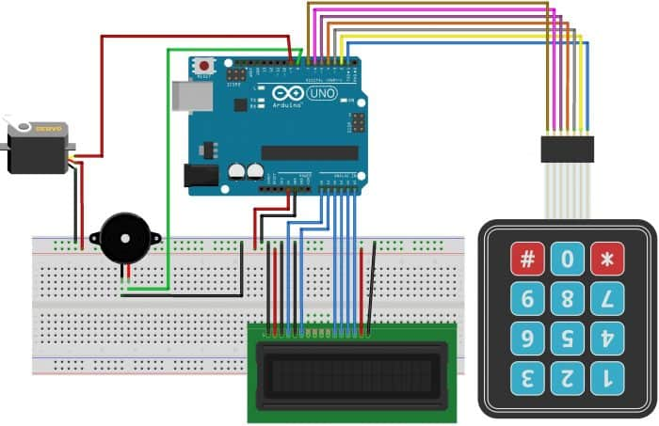
CIRCUIT DIAGRAM:

Slide 7
COMPONENTS:
Arduino board
4x4 keypad
Lcd display
Servo motor
Breadboard
Buzzer
Jumper wires

Slide 8
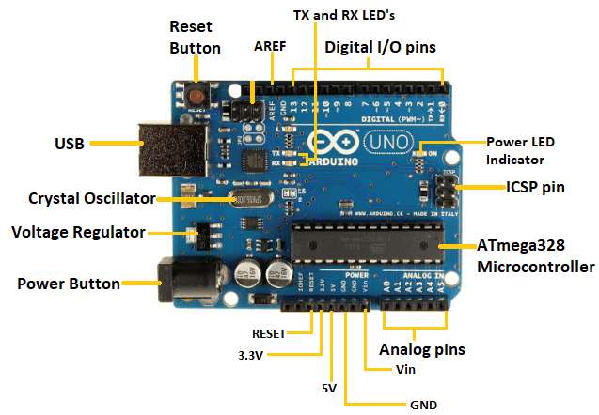
ARDUINO UNO :
Arduino UNO is a microcontroller board based on the ATmega328P.
It has 14 digital input/output pins (of which 6 can be used as PWM outputs), 6 analog inputs.

Slide 9
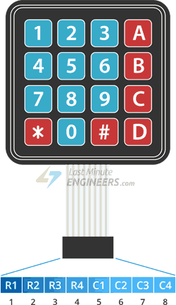
4X4 MATRIX KEYPAD :
The 4×4 matrix keypad is an input device, it usually used to provide input value in a project.
It has 16 keys in total, which means it can provide 16 input values.

Slide 10
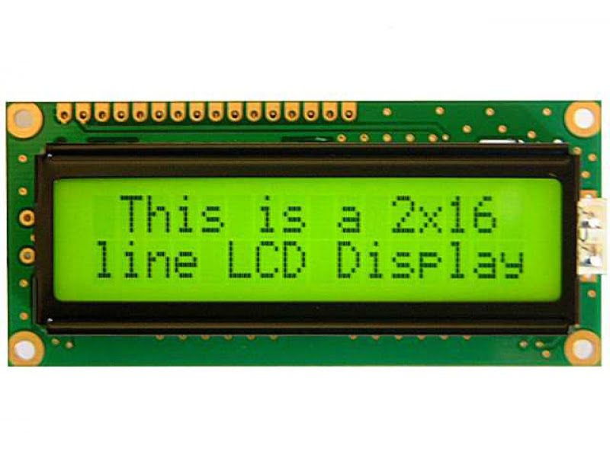
LCD DISPLAY :
It stands for “Liquid Crystal Display”.
LCD is a flat panel display technology commonly used in TVs & computer monitors.

Slide 11
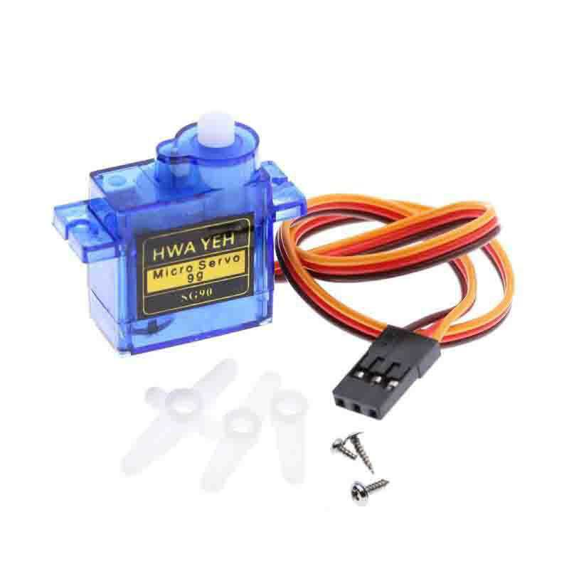
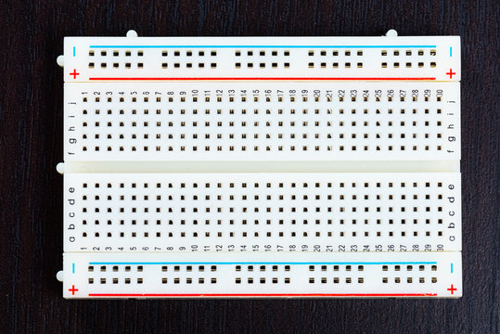
SERVO MOTOR:
The servo motor is an electric motor, which enables continuous determination of precise positions, speeds and torque via control electronics (servo controller) .
Micro Servo Motor SG90 is a tiny and lightweight servo motor with high output power. Servo can rotate approximately 180 degrees.
BREAD BOARD:
A breadboard, solderless breadboard, protoboard, or terminal array board is a construction base used to build semi-permanent prototypes of electronic circuits.

Slide 12
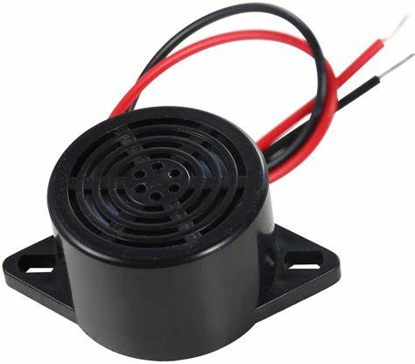
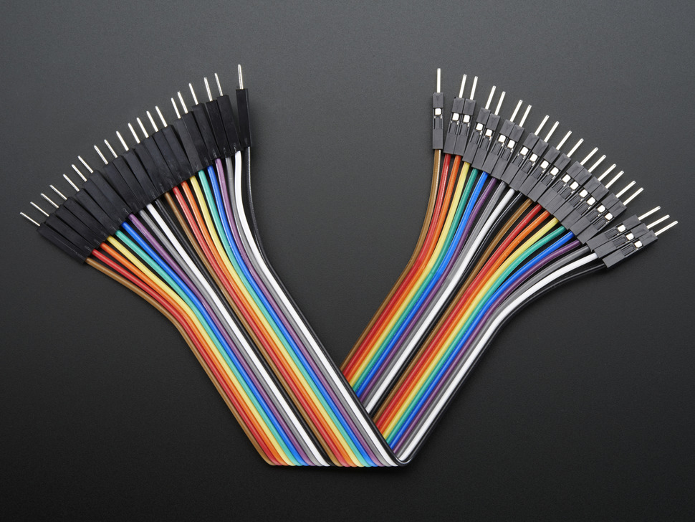
BUZZER:
A buzzer is a small yet efficient component to add sound features to our project/system.
It is very small and compact 2-pin structure hence can be easily used on breadboard.
The frequency range of this ranges from 2 kHz to 4kHz.
JUMPER WIRES:
Jumper wires are simply wires that have connector pins at each end, allowing them to be used to connect two points to each other without soldering.

Slide 13
WORKING:
We implemented the whole circuit in the software and uploaded the code for compilation, and it started the simulation .
At first, the keypad was connected with the Arduino UNO & connected all the necessary pins of the Keypad to the Arduino board. All 7 pins were connected using connecting wires.
Then we connected a 16×2 LCD Display to Arduino UNO. And also a 10K Ohm Potentiometer connected to the display for managing the voltage of the display.
Later we connected Servo Motor to the Arduino, the rotation of Servo Motor allows us to open or close the door. All the pins were connected wires.

Slide 14
We have to define the default password in the Arduino. You can change it via coding. When we enter a password in matrix keypad, it will match the password stored in the Arduino. If it is correct, then it will show “access granted", welcome’ & then rotate the servo motor into 180 degrees as the door is opened. It will give 15 seconds time for entering via the door. Once the 15 seconds is completed, the door will get locked automatically.
If the password is wrong, then it will show code incorrect go away, the buzzer will also beep once when any key is pressed.

Slide 15
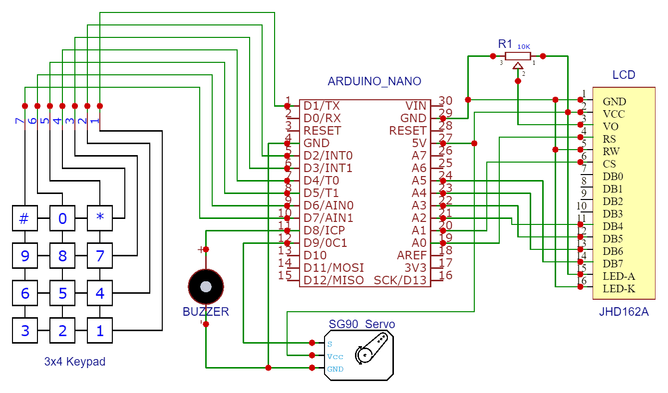
Schematic:

Slide 16
APPLICATIONS:
Can be used at residential places to ensure better safety
Used at organizations to ensure authorized access to highly secured places
Home access security
Office access security
Garage automation access
Home automation access

Slide 17
ADVANTAGES:
Provide ease and automation
Keyless system(hence no more worry of losing of keys)
Provides security
Power consumption is less
Automatic door opening
Gives indication for unauthorized entry
Cost efficient

Slide 18
DIS ADVANTAGES:
If personal identification number is somehow forgotten the system could not be accessed.
Powered by electricity, may not function properly in case of a power failure.

Slide 19
FUTURE SCOPE:
We can send this data to a remote location using mobile or internet.
We can add fingerprint sensor so entry will be allowed for the authorized person using their fingerprints.
We can add fire, wind and LPG sensors so that in case of accident, the doors will automatically open.

Slide 20
CONCLUSION:
Password based door locking security system is used in the places where we need more security.
It can also used to secure lockers and other protective doors

Slide 21


Slide 22


